Slide 1
Battery
ESC
Motor
PDB
BEC
(Backup system)
BEC (Servos)
Red – Power
Black – Ground
Yellow – Signal
Gray - Other
Pixhawk
Inductor
*From motor’s ESC, only signal and ground are needed
Aux Out
Servos
Main Out
Power

Slide 2
Servo BEC
Servos
Motor ESC
Telemetry Radio Receiver
Pixhawk
Aux Out 1
Aux Out 3
Aux Out 2
Aux Out 5
Aux Out 4
Main Out 1 – Right Aileron
Main Out 2 – Left Aileron
Main Out 3 – Right Elevator
Main Out 4 – Rudder
Main Out 5 – Throttle
Main Out 8 – Servo BEC 2
Aux Out 1 – Servo BEC 1
Aux Out 2 – Left Elevator
Aux Out 6
Main Out 6
SBUS
Main Out 2
Main Out 8
Main Out 3
Main Out 4
Main Out 1
Main Out 5
RCIN
Main Out 7
SPKT/DSM
Buzzer
Telem 2
Switch
Serial 4/5
Tranceiver Set
Telem 1
GPS
GPS Module
AirSpeed sensor
USB
ADC 3.3 V
CAN
SPI
CRIUS I2C Splitter
12C
PDB
Power
ADC 6.6 V

Slide 3
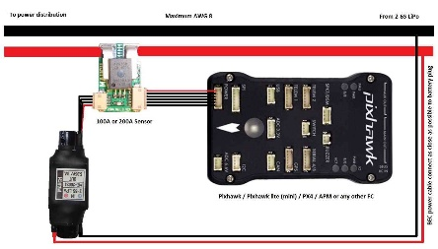
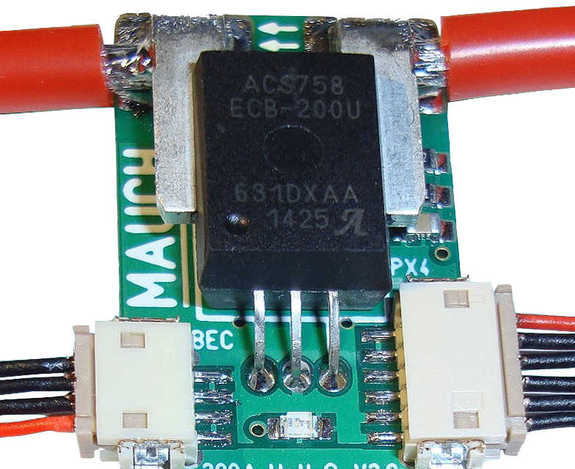
PDB
MAUCH Power Monitor
Provides necessary power to the Pixhawk and the rest of the system
Monitors battery power and sends information to the pixhawk

Slide 4
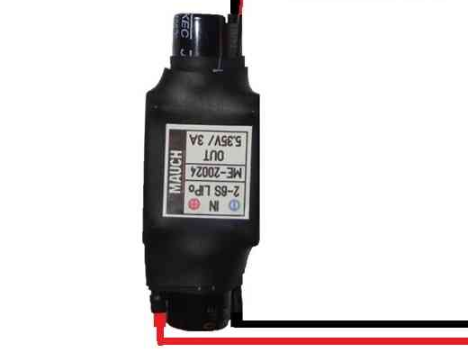
BEC (Battery Elimination Circuit) (backup)
Mauch BEC
Connected to the main 12 V line as close to battery as possible
Drops voltage to 5 V and feeds into the PDB
Used to drop voltage for pixhawk

Slide 5
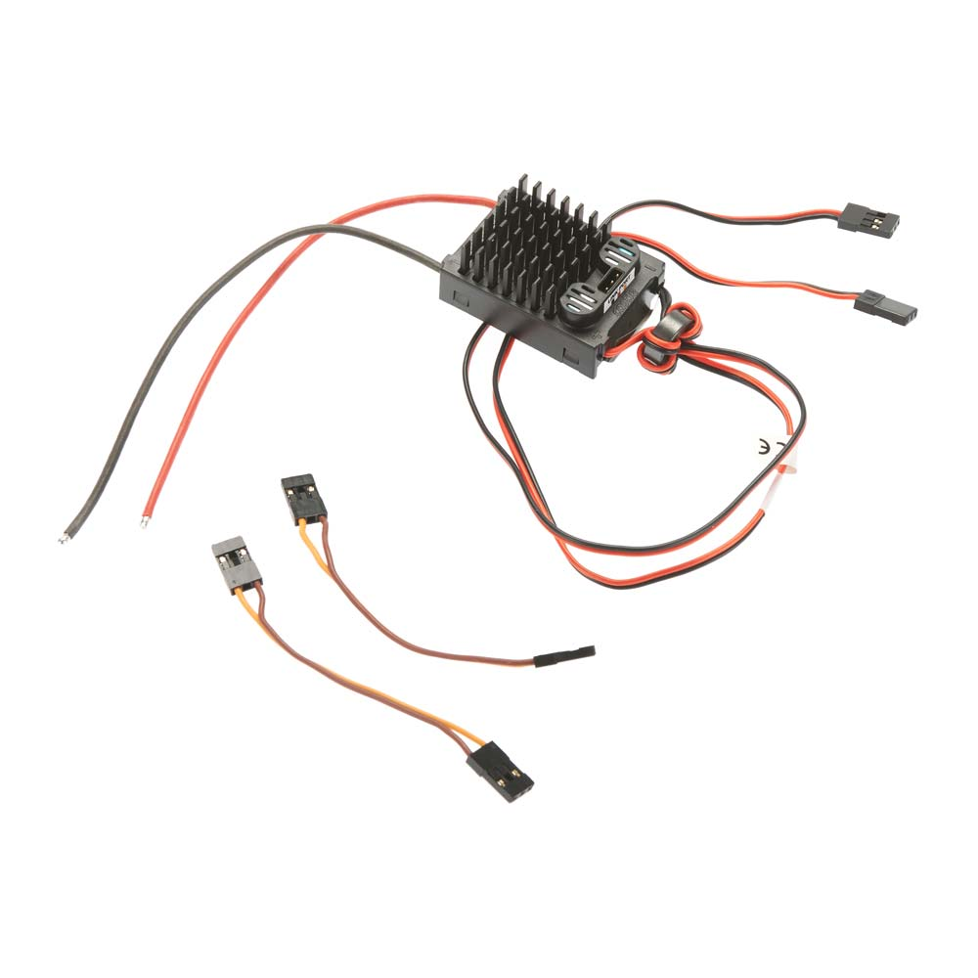
BEC (Battery Elimination Circuit) (Servo)
Castle Creations CCBEC pro
Connected to the main 12 V
Drops voltage to 5 V and feeds into the both the Aux and Main servo Rails on the pixhawk
Used to drop voltage to 5V to power the servos

Slide 6

ESC (Electronic Speed Controller)
Phoenix Edge
Used to control the motor
Powered via the 12 V line
Takes PWM input from the Pixhawk main 5 channel
PWM input line has an inductor

Slide 7

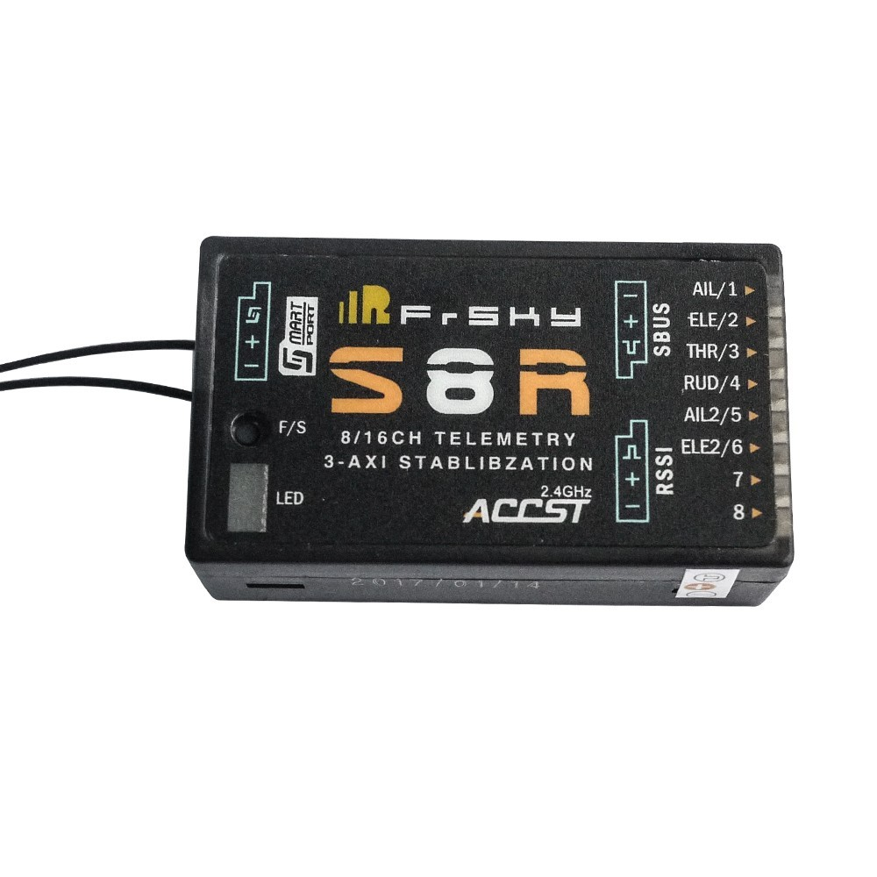
Telemetry Radio Receiver
FrSky S8R 8/16ch Receiver
Receives radio commands from the Taranus controller
Sends commands to pixhawk via RCIN

Slide 8
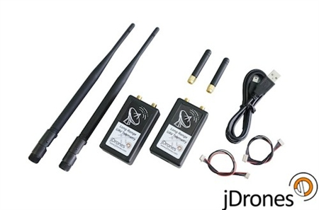
Transceiver Radio set
jD-RF900Plus Longrange
Communicate between the pixhawk and the GroundStation
The Fixed wing transceiver is plugged into the Telemetry 1 port
The Ground station Transceiver is plugged into a computer via USB

Slide 9
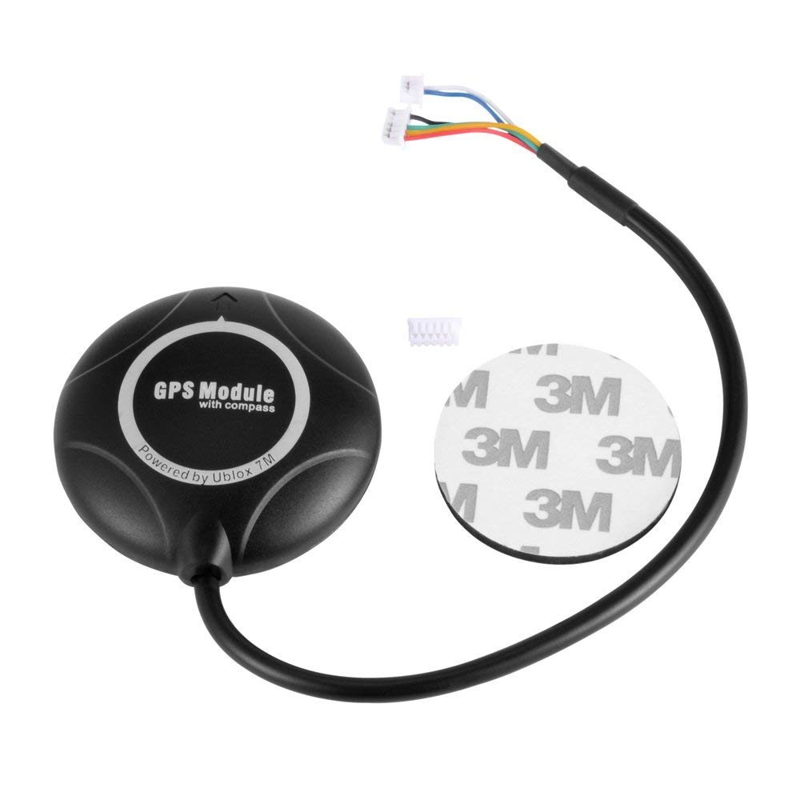
GPS
Provides GPS signal to pixhawk
Cables go to I2C splitter & GPS port on the pixhawk

Slide 10
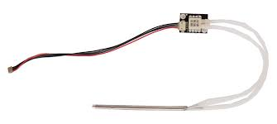
Airspeed Sensor
MS5525 airspeed sensor
Senses airspeed
Connected to I2C port on the Pixhawk

Slide 11
Cirius Pixhawk-i2c Splitter Expand Module for Pixhawk APM Flight Controller

